Slide 1

IOT based Solar Monitoring Dashboard
Software Engineering Project

Slide 2
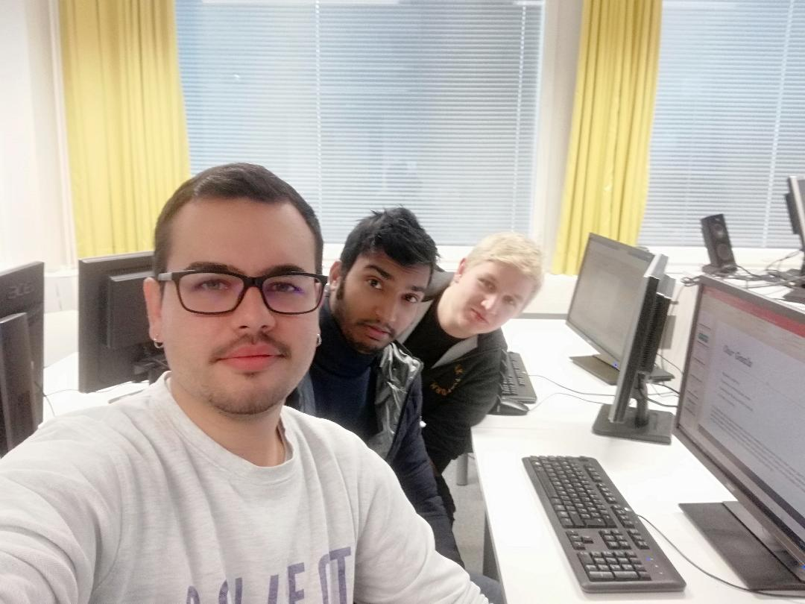
Our Team
1. Md Farukul Islam (Project Manager and developer)
2. Albin Westerlund (Team member and Developer)
3. Carlos Martinez de la Riva Valdaliso (Team member and Developer)
Our Client
1. Timo Kankaanpaa

Slide 3
Project Overview
Iot-ticket
Our Goals
Project Roadmap
Working Methods and Tools
Conclusion
References

Slide 4
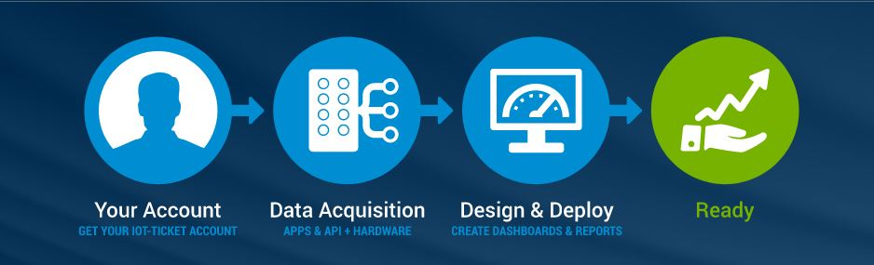
Iot-Ticket
IoT-Ticket is a complete remote management system that includes the electronics, software and server.

Slide 5
Our Goals
Client will be able to monitor electricity produced and live production
Estimated production using weather data

Slide 6
Project Roadmap
The project is done by using the scrum method and sprints.
On every lecture ( weekly 2 lecture) we stand for our scrum meeting on VAMK campus.
The project is divided into three sprints.
Each sprint contains 10 issues/tasks based on our project.
We use Redmine for maintaining schedule, task, project file and kanban board.

Slide 7
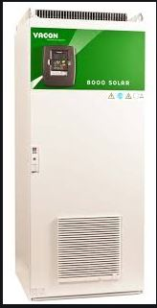
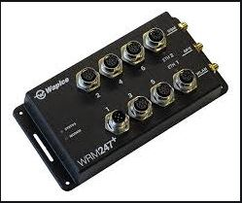
working methods and tools
Wapice’s IoT-Ticket.com Online platform for Creating Dashboard,
Wapice’s WRM 247+ module
Vacon 8000 inverter at Technobotania
https://git.vamk.fi/e1701764/iot_solarplant

Slide 8
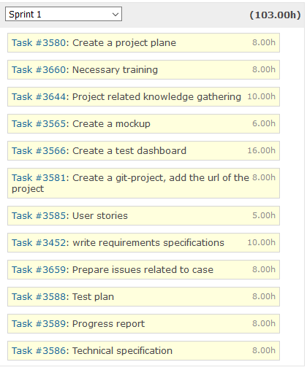
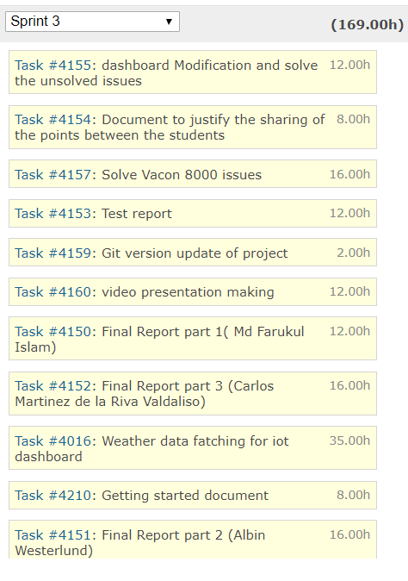
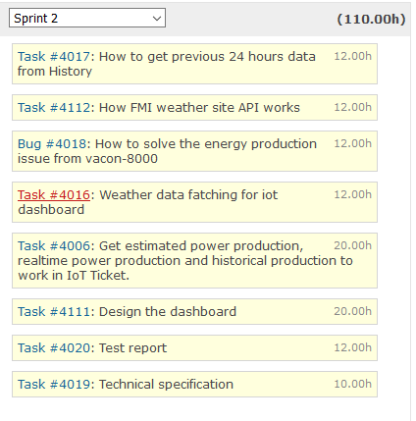
Planned hours(Redmine)

Slide 9
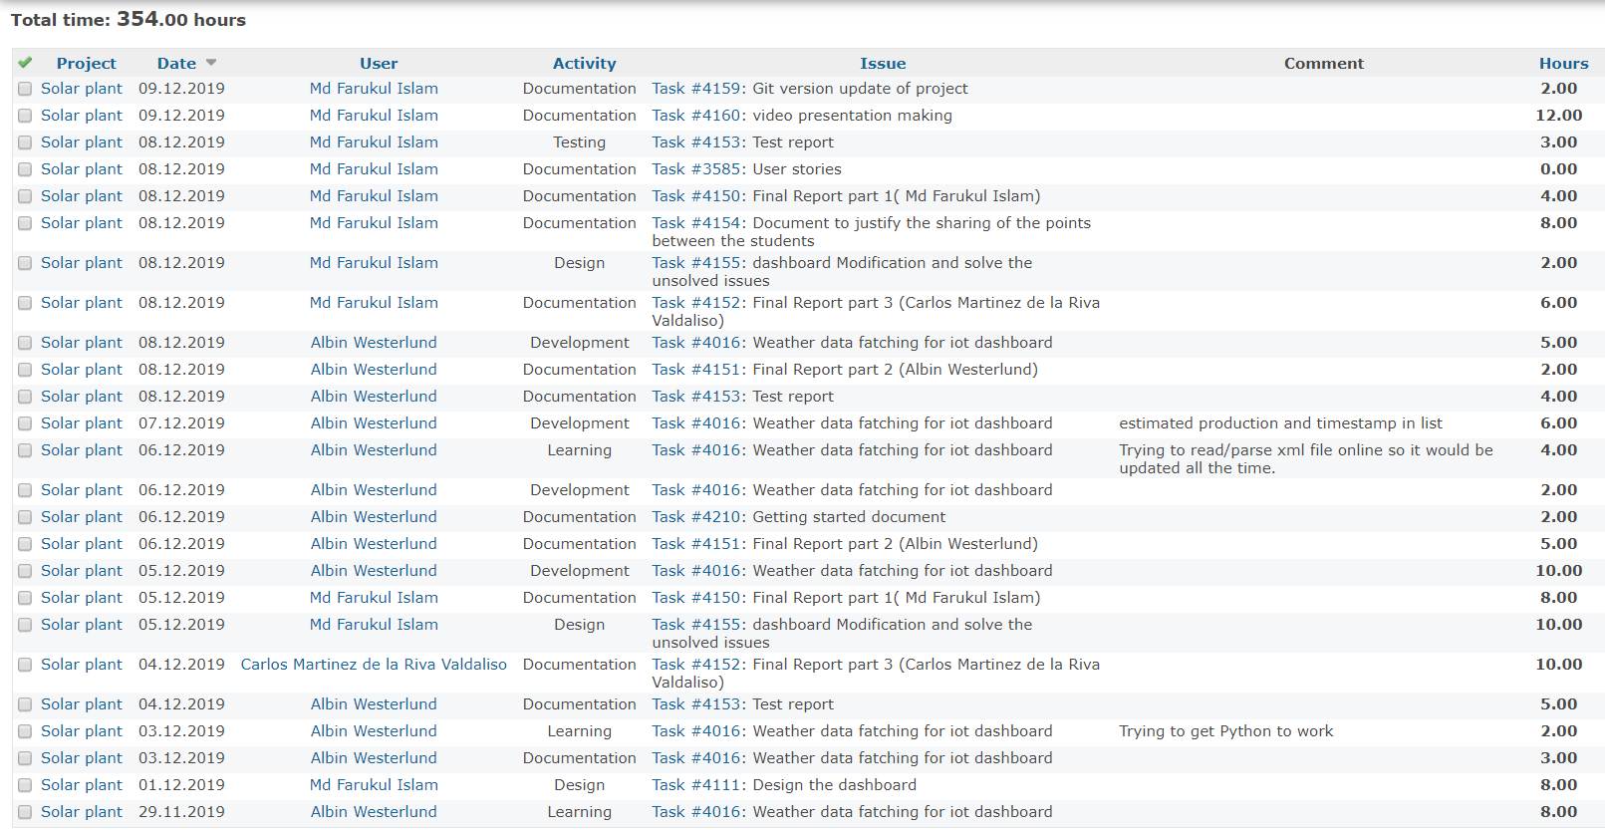
Actual hours (Spent time Redmine)

Slide 10
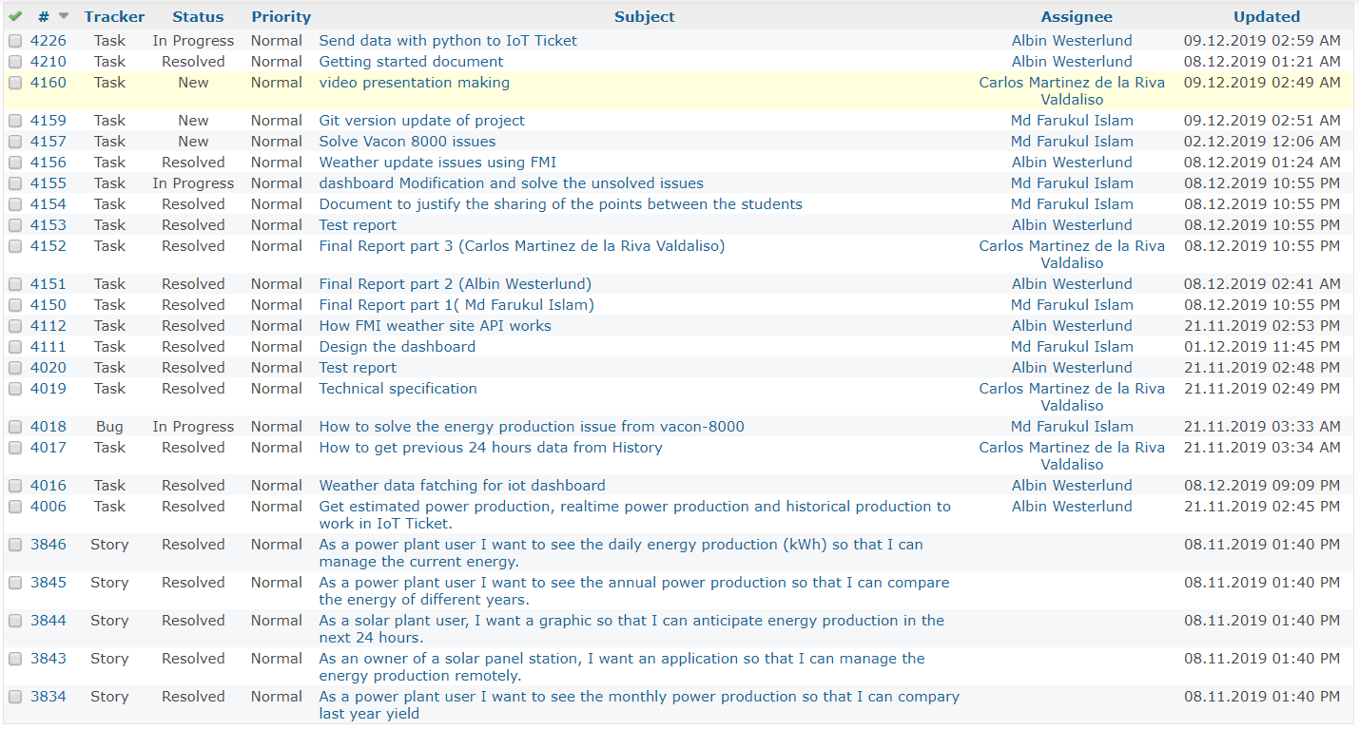
Issues Status (Redmine)

Slide 11
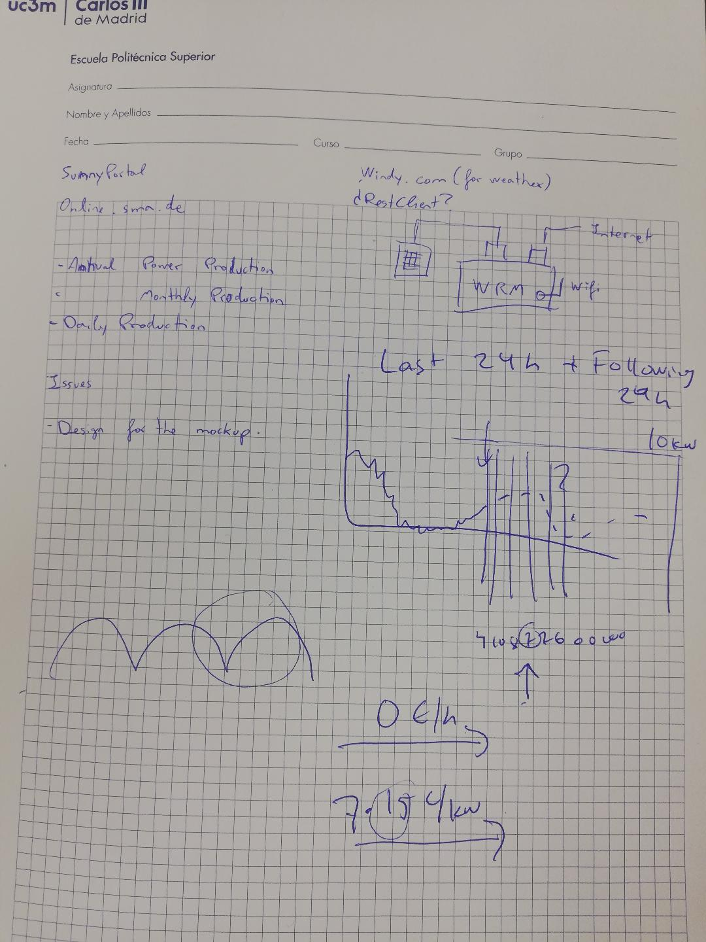
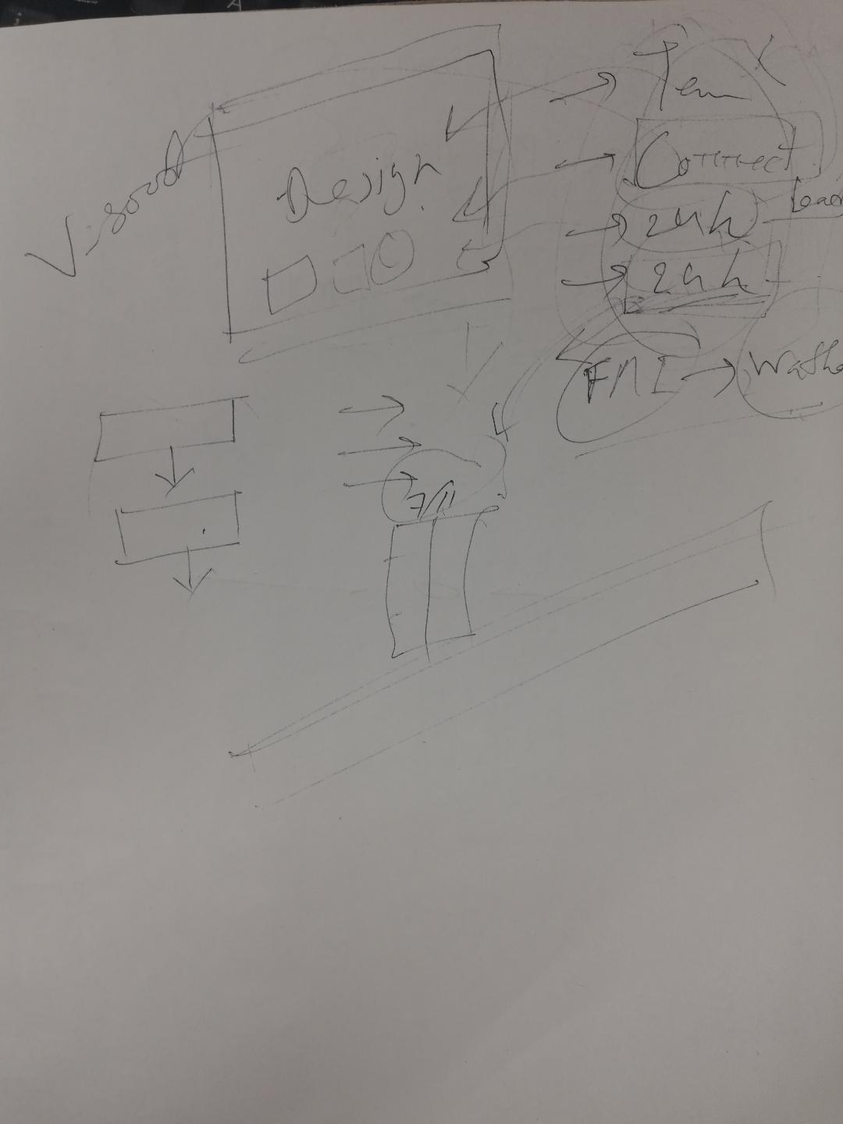
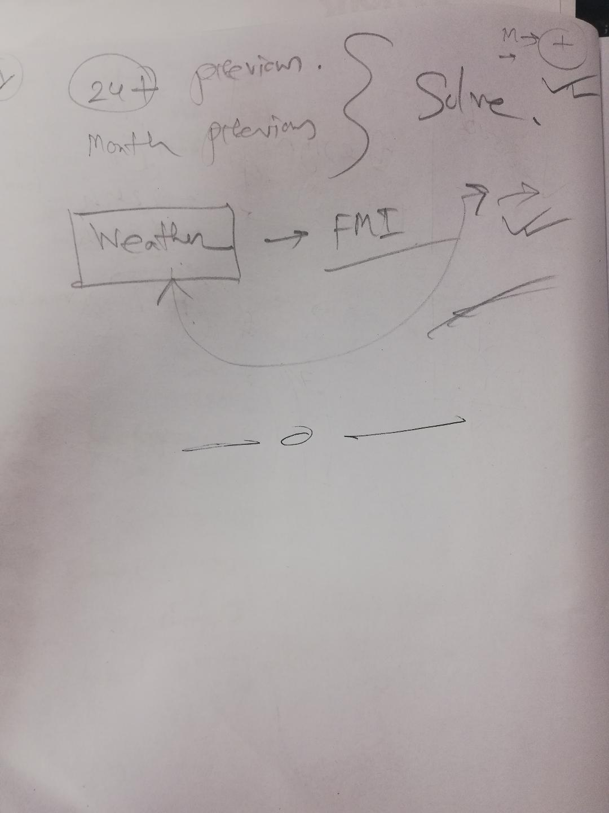
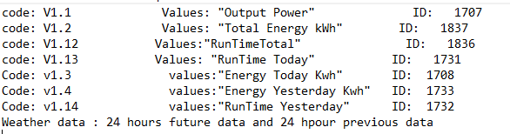
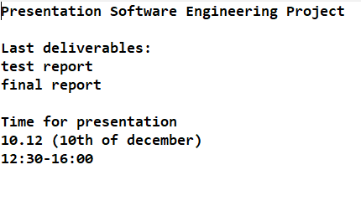
Meeting Notes

Slide 12
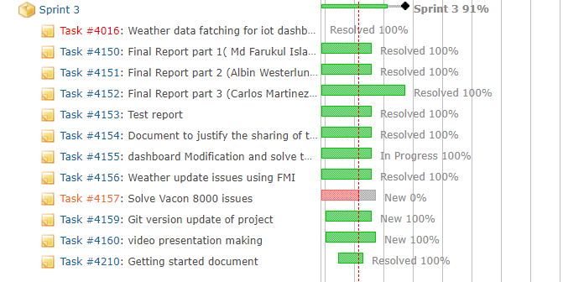
Sprint 3 (Redmine)

Slide 13
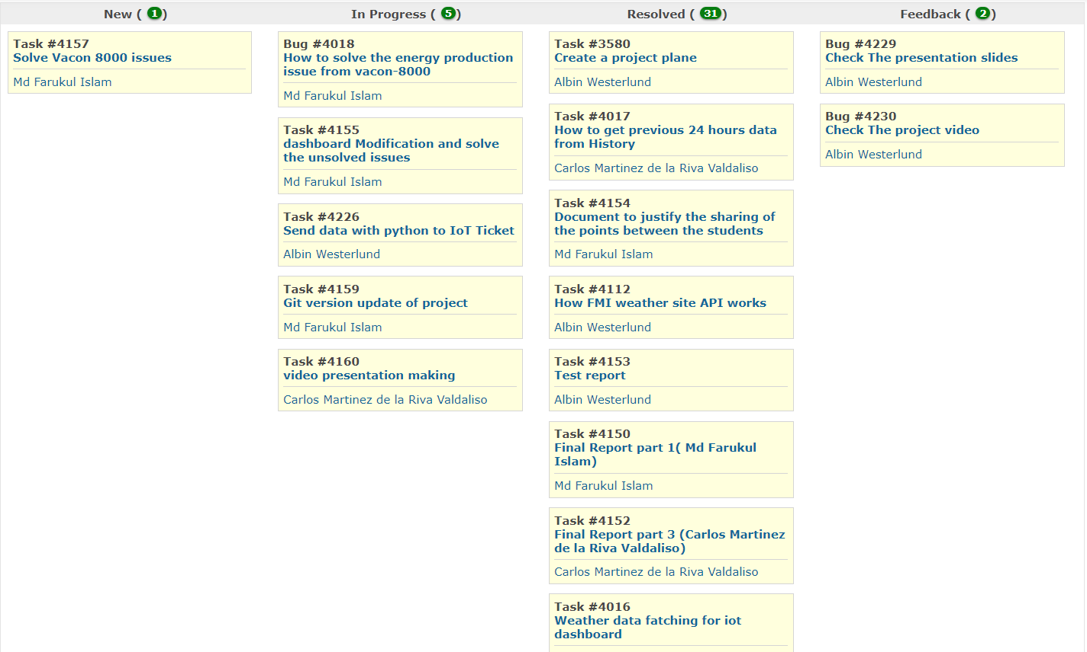
Kanban board (Redmine)

Slide 14
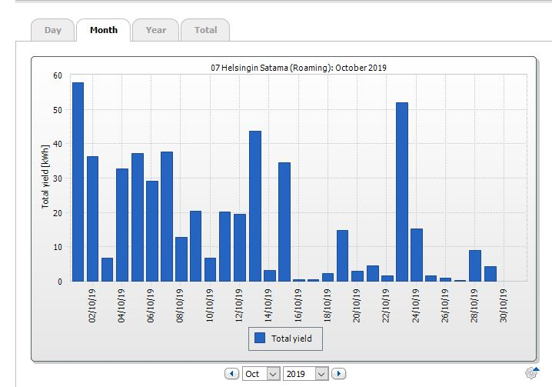
Our Mockup

Slide 15
Project Demo
https://my.iot-ticket.com/Dashboard/#desktop/nJVsb4vTpF2IQE27BA80n5/1

Slide 16
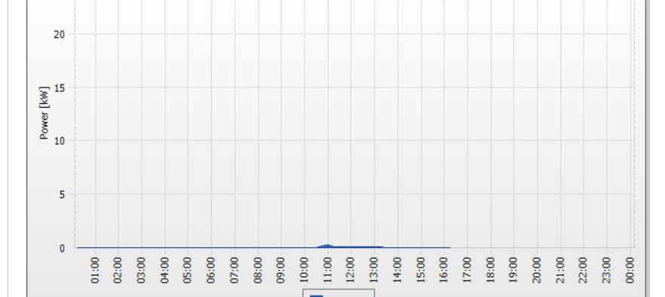
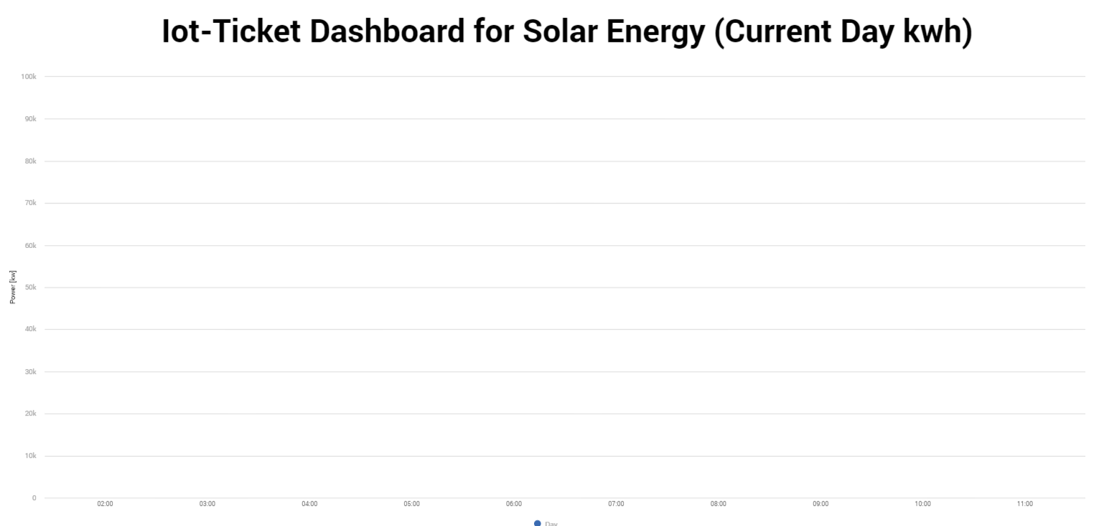
Comparison (Vaasan Sähkö vs Our value)

Slide 17
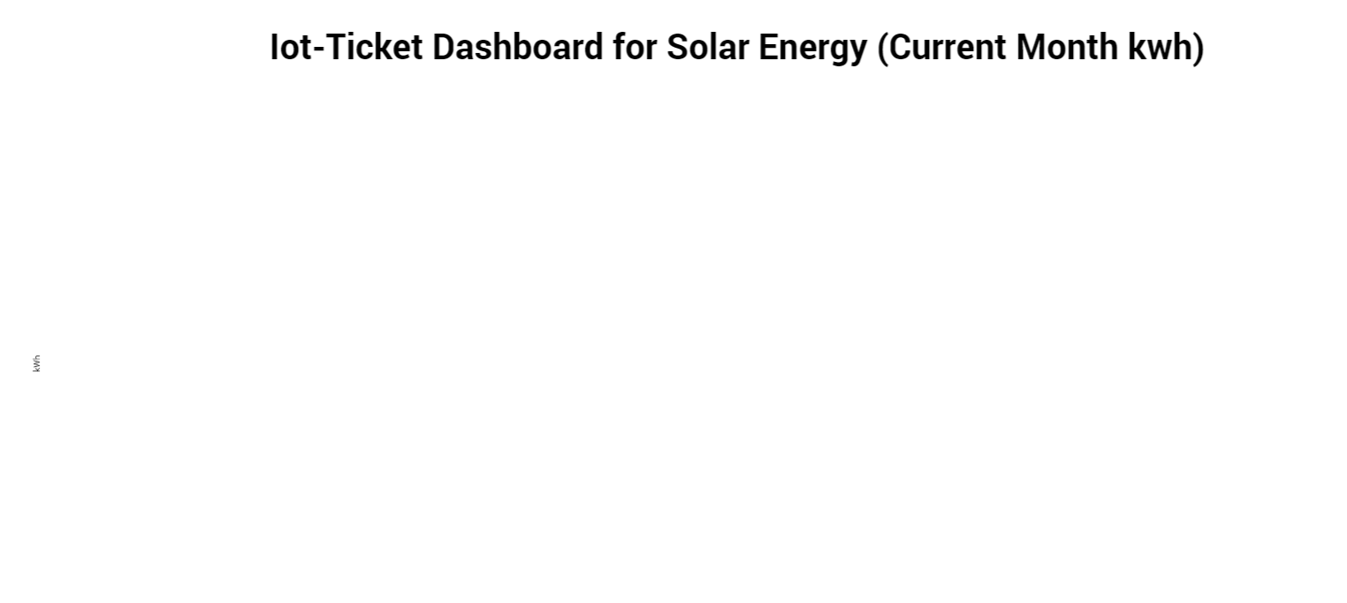
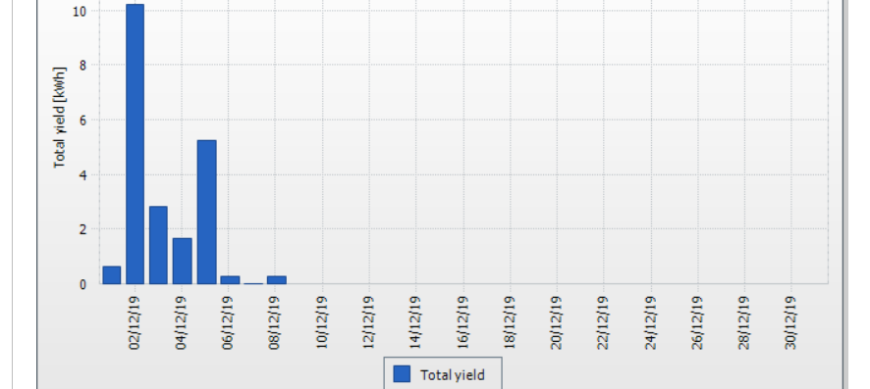
Comparison (Vaasan Sähkö vs Our value)

Slide 18
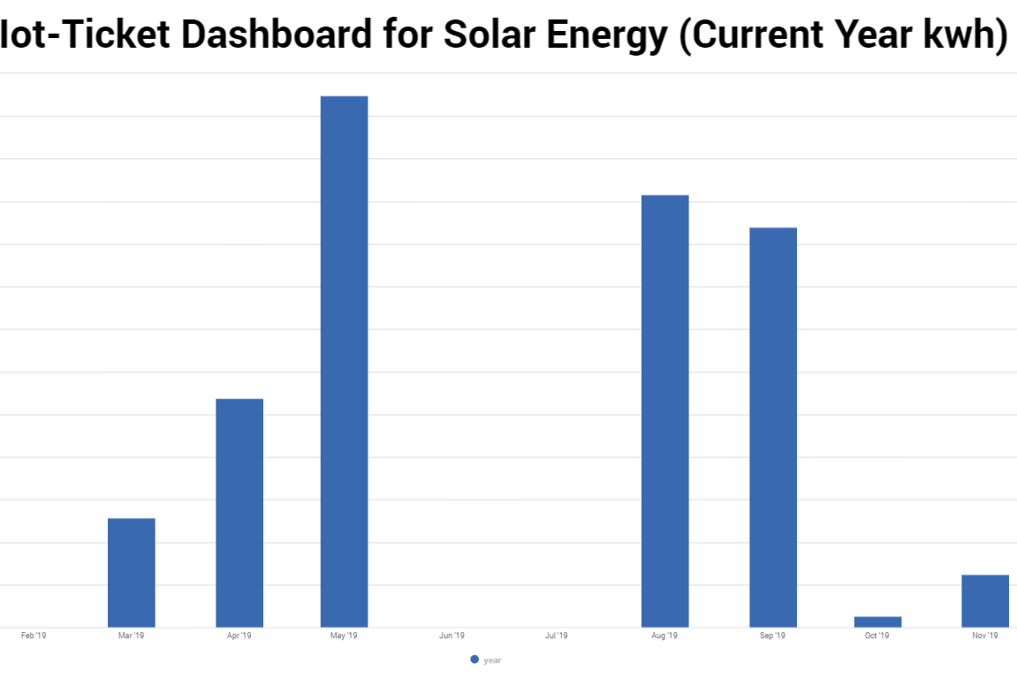
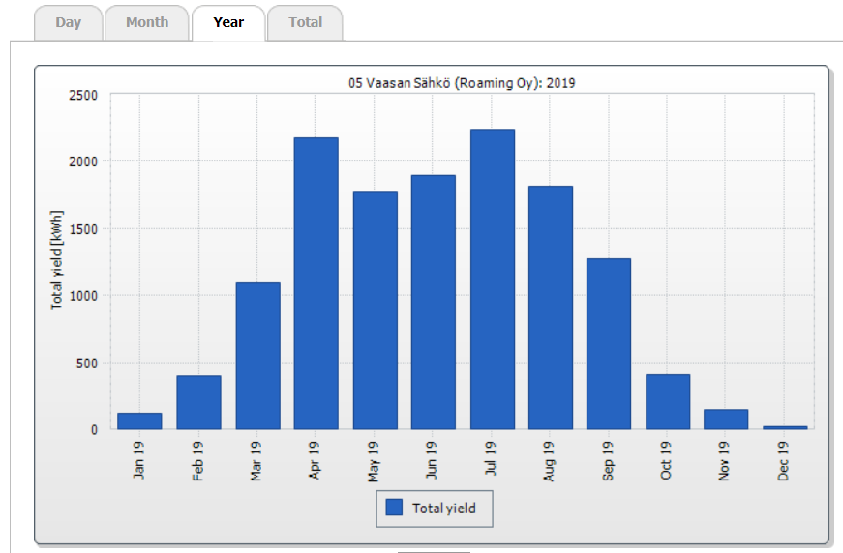
Comparison (Vaasan Sähkö vs Our value)

Slide 19
Reference
VACON-8000-Solar-NXV0010-NXV0100-Manual-DPD00426A-UK
WRM247+_DataSheet_2015
https://iot-ticket.com/platform
https://omega.cc.puv.fi/redmine/projects/solar/files
https://omega.cc.puv.fi/redmine/projects/solar/wiki

